Slide 1
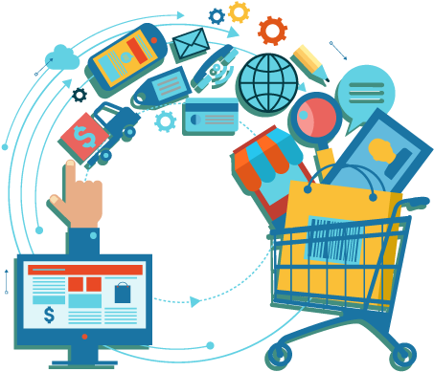
PRESENTATION ON
MARKET BASKET ANALYSIS
(USING RFM ANALYSIS)
PRESENTATION ON
INSURANCE FORECAST
Presented By:
Sushree Sangeeta Jena
PGDA27

Slide 2

CONTENTS
01
Problem Statement
02
Dataset Description
03
Methodology
04
Key Findings
05
Future Scope

Slide 3
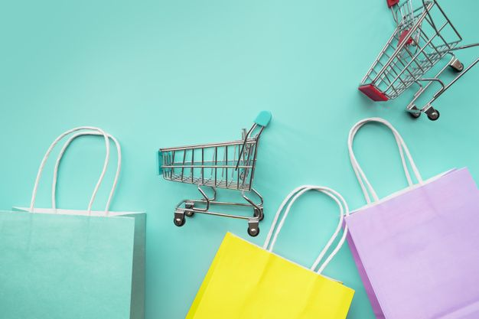
PROBLEM STATEMENT

Slide 4
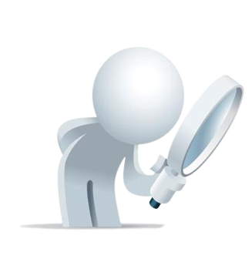
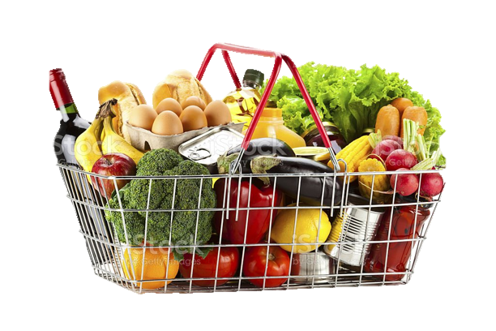
Market Basket Analysis and RFM Analysis using Machine Learning is widely used in the retail and ecommerce industry.
Machine Learning Algorithms are widely used to derive information about top line and bottom line business. Proper Segmentation of the customers helps to plan better and thereby helping in increasing revenues and customer retention.
We are required to find out which products are frequently purchased by the customers by understanding the past buying patterns and segmenting into different clusters, using RFM analysis.

Slide 5
DATASET DESCRIPTION

Slide 6
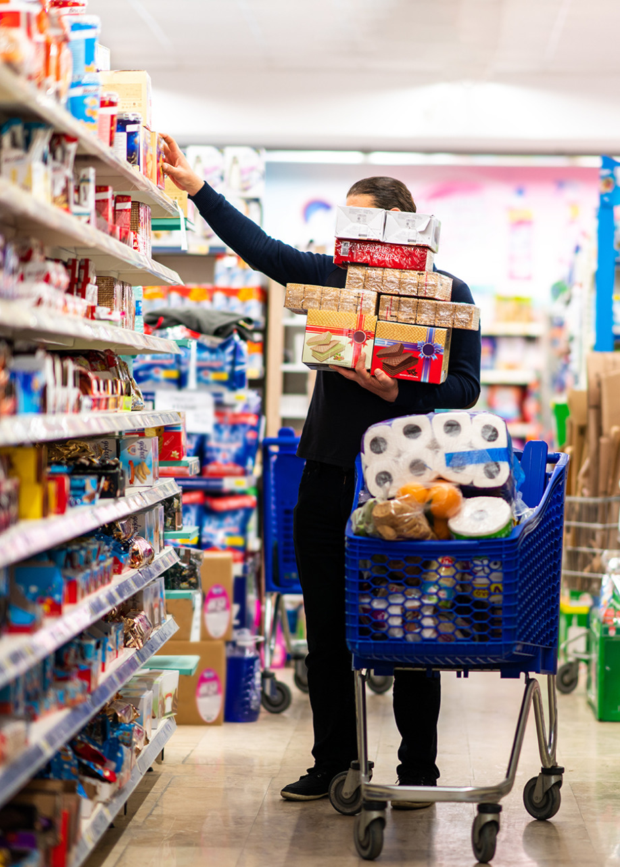
Context:
This dataset contains online retail transactions with details about the items purchased. There are over half a million transactions in total, i.e., 541909.
Objective:
To provide customized recommendations to the customers based on the segmentation derived from RFM Analysis.

Slide 7
Attributes:
InvoiceNo: Generated when a particular purchase is completed
StockCode: Helps in identifying a particular product
Description: Name of the Product
Quantity: Number of Items Purchased
InvoiceDate: Date and Time of transaction
UnitPrice: Price of one item
CustomerID: Unique number to identify the customer
Country: Place where the particular transaction occured

Slide 8
METHODOLOGY

Slide 9
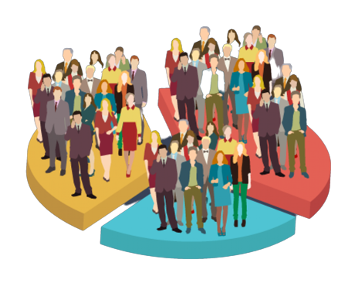

Customer Transactions
Customer Segmentation
Market Basket Analysis
RFM Analysis
Kmeans Clustering
Apriori Algorithm

Slide 10
02
RFM Analysis
01
03
05
Dataset Preparation
Kmeans Clustering
Apriori Algorithm
04
Customer Segmentation Comparison

Slide 11
Checking and removing Duplicate Transaction records
Checking and removing Null Values in the dataset
Removing the negative values in the Quantity and Price column since it is not feasible in real world scenario
Creating a backup of the dataset
01
Dataset Preparation

Slide 12
02
RFM Analysis
01
03
05
Dataset Preparation
Kmeans Clustering
Apriori Algorithm
04
Customer Segmentation Comparison

Slide 13
It stands for the Recency, Frequency and Monetary value analysis used in Marketing Analytics.
02
R
F
M
RFM Analysis
Recency
Frequency
Monetary

Slide 14
Recency
The last time the customer made a purchase
Based on the CustomerIDs, we have considered the most recent purchase made
Then, finding the most recent date, and subtracting other transaction dates to find the recency
The lesser the no. of the days, we can know that, that customer has made a recent purchase
02
RFM Analysis

Slide 15
It stands for the Recency, Frequency and Monetary value analysis used in Marketing Analytics.
02
R
F
M
RFM Analysis
Recency
Frequency
Monetary

Slide 16
Frequency
The total number of times the customer has made a purchase in a given period of time
Based on the CustomerIDs, we have counted the number of invoices generated, which gives us an idea about the number of purchases made
The higher the number of invoices generated, we can know that, the customer is doing frequent purchases
02
RFM Analysis

Slide 17
It stands for the Recency, Frequency and Monetary value analysis used in Marketing Analytics.
02
R
F
M
RFM Analysis
Recency
Frequency
Monetary

Slide 18
Monetary
The total amount spent by the customer for making a purchase
We have calculated a new column showing Total (Quantity*UnitPrice)
Based on the CustomerIDs, we have calculated the sum of invoices generated, giving us an idea about the total amount spent by the customer
The higher the total amount, we can know that, the customer is spending more money for making purchases
02
RFM Analysis

Slide 19
It stands for the Recency, Frequency and Monetary value analysis used in Marketing Analytics.
02
R
F
M
RFM Analysis
Recency
Frequency
Monetary
Next step is to merge all the three data frames into a single data frame and forming rfm scores from 1 to 4.
Adding these scores as a string to get the rfm_segment and as an integer to get total rfm_score
Analysing the summary metrics (summary metrics) and segmenting into gold, silver and bronze basket

Slide 20
02
RFM Analysis
01
03
05
Dataset Preparation
Kmeans Clustering
Apriori Algorithm
04
Customer Segmentation Comparison

Slide 21
After creating clusters using RFM Analysis, we also created clusters using Kmeans Clustering
For this, we scaled the Recency, Frequency and Monetary values and created clusters using Elbow Method
4 clusters were formed in total, post which we categorised different data points into respective clusters
03
Kmeans Clustering

Slide 22
02
RFM Analysis
01
03
05
Dataset Preparation
Kmeans Clustering
Apriori Algorithm
04
Customer Segmentation Comparison

Slide 23
Comparing the outcomes of cluster creation using RFM Analysis and Kmeans Clustering,below mentioned points could be summarised:
Cluster3 has maximum number of people where Cluster2 has minimum number
Going deeper, we find that the Gold Segment people have been categorised under Cluster3.
A sidewise comparison is shown here. (link)
04
Customer Segmentation Comparison

Slide 24
02
RFM Analysis
01
03
05
Dataset Preparation
Kmeans Clustering
Apriori Algorithm
04
Customer Segmentation Comparison

Slide 25
Helps us to identify relations between products in a dataset. Used widely in Basket Analysis, where we try to determine which products come together
Finds the most frequent combinations in a database and identifies the association rules between the items, based on:
Support- probability of X and Y occurring together
Confidence-probability of Y occurring knowing that X has already occurred
Lift-Ratio of support and confidence
05
Apriori Algorithm

Slide 26
02
RFM Analysis
01
03
05
Dataset Preparation
Kmeans Clustering
Apriori Algorithm
04
Customer Segmentation Comparison

Slide 27
KEY FINDINGS

Slide 28
01
RFM Analysis and Kmeans Clustering help in customer segmentation thereby helping us to make business strategies
02
Customers with lower recency, higher frequency and monetary are the ones with higher RFM scores and are the premier customers
03
Apriori Algorithm works better for large datasets and help us to find the association between two products
04
Apriori Algorithm helps in product recommendation, increase revenues, customer retention, etc

Slide 29
FUTURE SCOPE

Slide 30
01
Apriori Algorithm can be used for Silver and Bronze segment to understand their purchasing behaviour
02
We can conduct analysis based on the countries to understand the customer purchase
03
Item Based Collaborative Filtering can also be considered to recommend products and comparison can be made between the algorithms

Slide 31
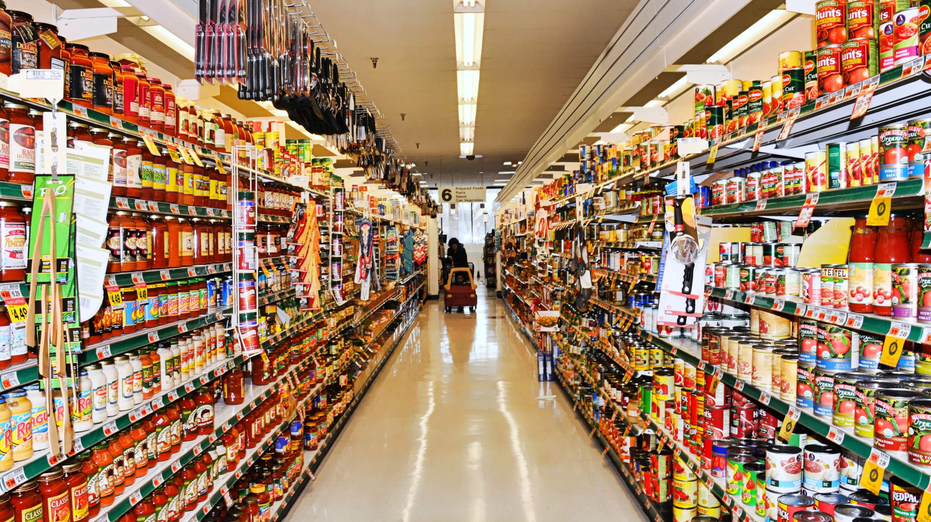
THANK YOU

